Slide 1
DATA EMBEDDING USING ADAPTIVE PIXEL PAIR MATCHING
Under Esteemed guidance of
Mr. S.V. Kishore Babu (M.Tech)
Asst. Professor of CSE
presented by,
V. Srinivas (09E91A0533)
B. Nagaraju (09E91A0534)
V.Bangarubabu (09E91A0508)
K.Karteek (09E91A0525)

Slide 2
Abstract
This is a new data hiding method based on pixel pair matching(PPM) by cover image, on data. the basic idea of PPM is to use the values of pixel pair as a reference coordinate, and search a coordinate in the neighborhood set of this pixel pair according to a given message digit. the pixel pair is then replaced by the searched coordinate to conceal the digit.

Slide 3
Existing system
The least significant bit substitution(LSB) method, is a well-known data-hiding method. this method is easy to implement with low CPU cost, and has become one of the popular embedding techniques, in this two pixels as an embedding unit to conceal a message digit Sb in a B-ary notational system.

Slide 4
Disadvantages of existing system
Imbalanced embedding distortion emerges and is vulnerable to steganalysis.
The existing technique can be easily cracked

Slide 5
Proposed system
The basic idea of PPM is to use the values of pixel pair as a reference coordinate, and search a coordinate in the neighborhood set of this pixel pair according to a given message digit .the pixel pair is then replaced by the searched coordinate to conceal the digit. in this we can find out a f(x^,y^) from f(x,y).

Slide 6
Advantages of proposed system
The proposed method offers lower distortion than DE by providing more compact neighborhood sets and allowing embedded digits in any notational system. compared with the optimal pixel adjustment process (OPAP) method, the proposed method always has lower distortion for various payloads .

Slide 7
Hardware requirements
System :Pentium iv 2.4 GHz
Hard disk :40 gb
Monitor :15 VGA color
Mouse :Logitech
RAM :256 MB
Keyboard :110 keys enhanced

Slide 8
Software requirements
Operating system :windows xp
Front End :java
Tool :NET BEANS IDE

Slide 9
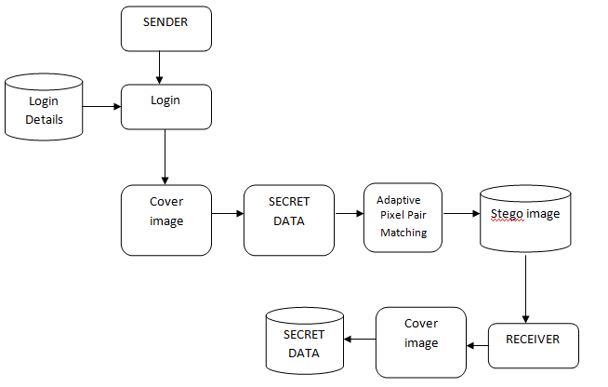
Architecture

Slide 10
Modules
Extraction function and neighborhood set.
Embedding procedure.
Extraction procedure.
Statistical analysis of the histogram.
Differences.

Slide 11
Extraction function and neighborhood set
In this module we perform the action of extraction function and neighborhood set. Where the system does a new data embedding method to reduce the embedding impact by providing a simple extraction function and a more compact neighborhood set.

Slide 12
Embedding procedure
Input: cover image of size x, secret bit stream and key. Output stego image.,and find the minimum satisfying ,and convert into a list of digits with a-ary notational the discrete optimization problem to find and in the region defined by, record the coordinate such that,. construct a no repeat random embedding sequence using a key.

Slide 13
Extraction procedure
To extract the embedded message digits, pixel pairs scanned in the same order as in the embedding procedure.the embedded message digits are the values of extraction function of the scanned pixel pairs.

Slide 14
Stastical analysis of the histogram differences
In this module ,we perform the goal of the system analysis by using histogram technique ,the goal of steganography is to evade statistical detection. it is apparent that MSE is not a good measure of security against the detection of steganalysis. Histograms are used to plot density of data and often for density estimation.

Slide 15
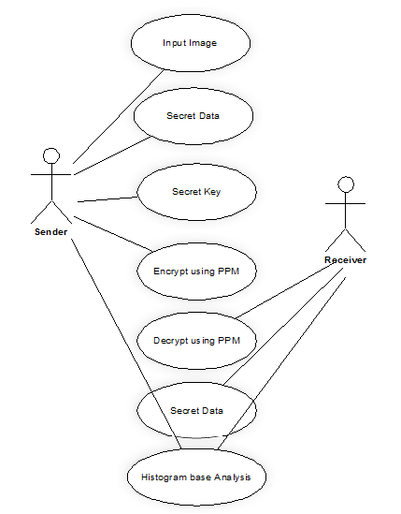
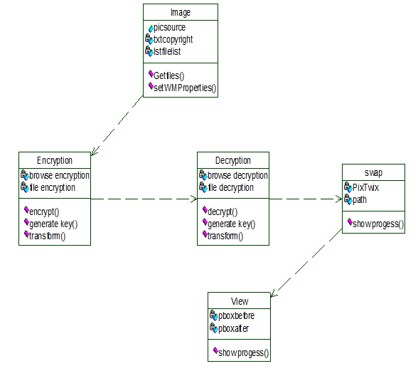
Class and usecase diagrams

Slide 16
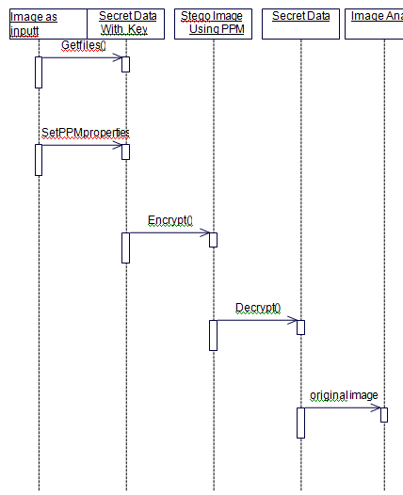
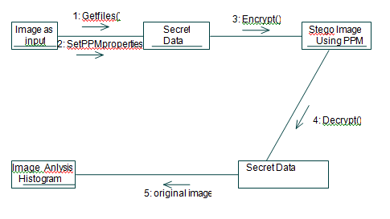
Sequence and collaboration diagrams

Slide 17
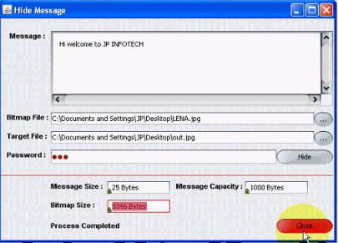
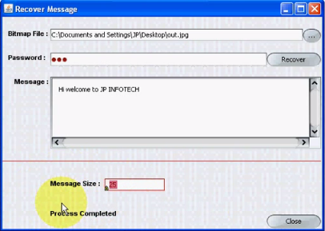
Output screens

Slide 18
Conclusion
This paper proposed a simple and efficient data embedding based on PPM. two pixels are scanned as an embedding unit and specially designed neighbourhood set is employed to embedded message digits with a smallest notation system .A PPM allows user to select digits any notational system for data embedding ,and then better image quality.

Slide 19
Reference
Wien Hong and Tung-Shou Chen, “A Novel Data Embedding Method Using Adaptive Pixel Pair Matching” , IEEE TRANSACTIONS ON INFORMATION FORENSICS AND SECURITY, VOL. 7, NO.1, FEBRUARY 2012.

Slide 20
Thank you

Slide 21
Queries plz.?????

